Slide 1
Robot Grocery Shopper
18-848 Autonomous Robotics II
Fall 2025

Slide 2
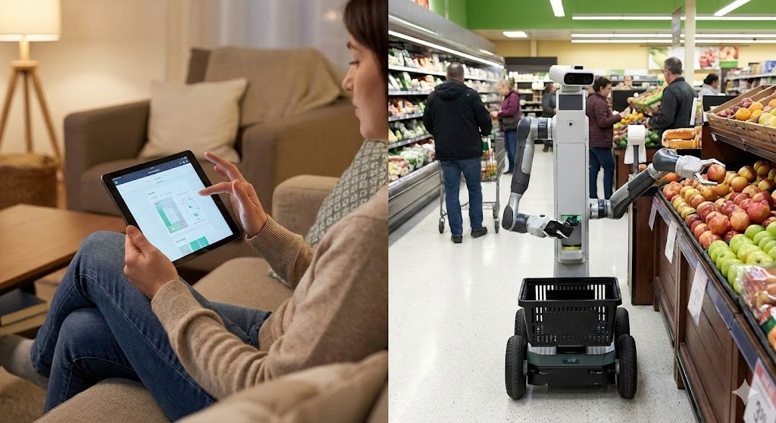
What are we trying to do?
We all use mobile shopping apps, some time, we find it convenient to call an Uber Eat or do Curbside pickup.
However, it still takes time for the associates to pick up the items for us.
Can we make it more convenient for both the customer and the staff working in the shop?
Notes:
We all use mobile shopping apps, some time, we find it convenient to call an Uber Eat or do Curbside pickup.
However, it still takes time for the associates to pick up the items for us.
Can we make it more convenient for both the customer and the staff working in the shop?

Slide 3
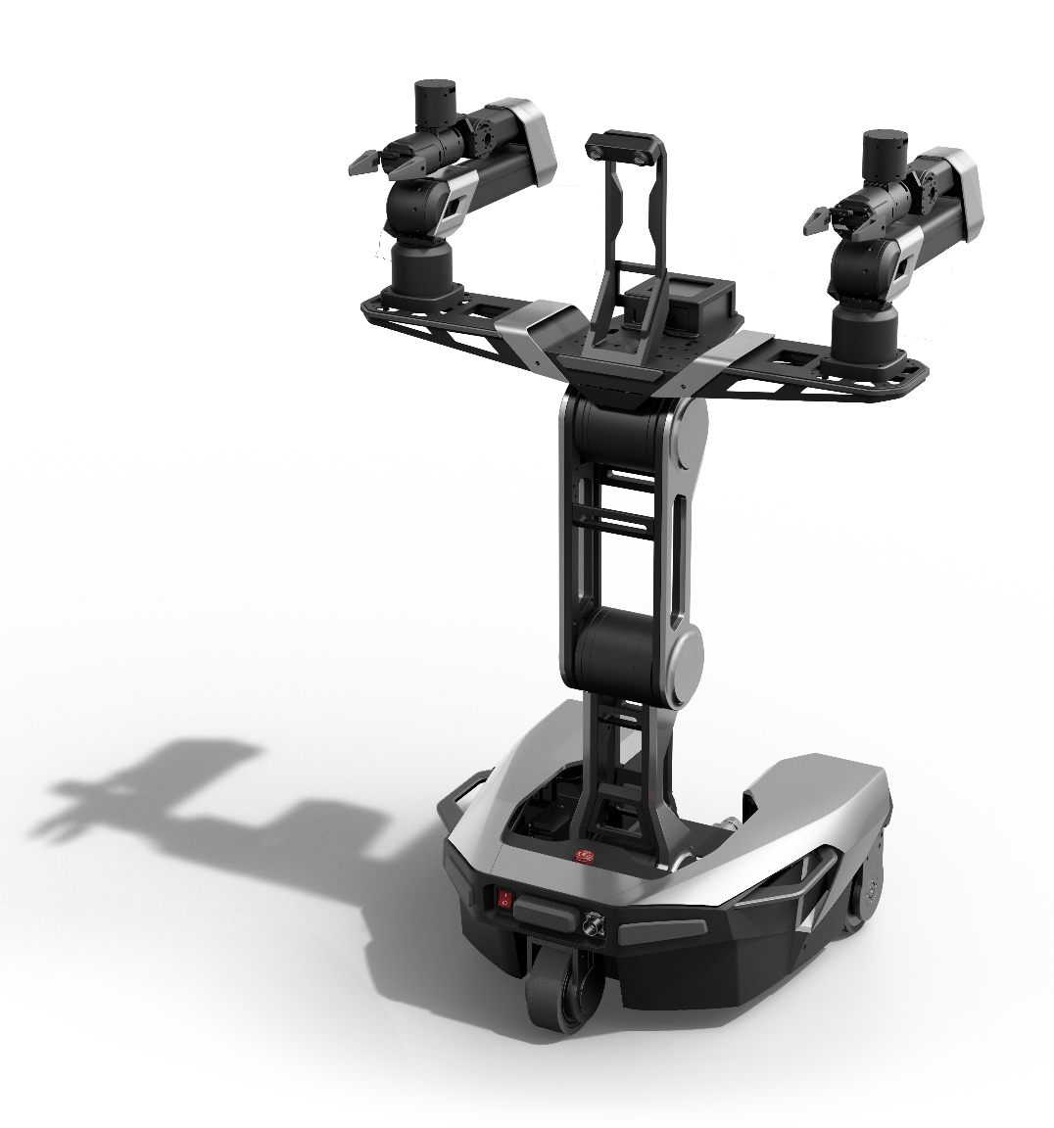
What are we trying to do?
We are trying to make a dual-arm robot with mobile base to:
Self-identify grocery items on the shelf,
Automatically identify, scan, and calculate the 6D pose of the target items.
Plan and execute the optimal trajectory to pick the item from the shelf and place into basket
Maintaining safe during the whole process.

Slide 4
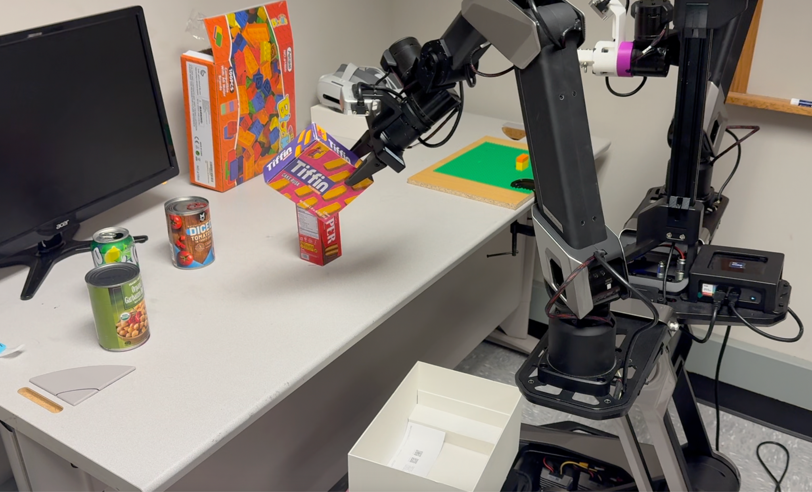
0. Updates from pre-demo
https://drive.google.com/file/d/1bvqm4vzGCk33N7ORQ7mD8Hd8S8-6cLIj/view?usp=share_link
Notes:
We all use mobile shopping apps, some time, we find it convenient to call an Uber Eat or do Curbside pickup.
However, it still takes time for the associates to pick up the items for us.
Can we make it more convenient for both the customer and the staff working in the shop?

Slide 5

Updates from pre-demo
Notes:
We all use mobile shopping apps, some time, we find it convenient to call an Uber Eat or do Curbside pickup.
However, it still takes time for the associates to pick up the items for us.
Can we make it more convenient for both the customer and the staff working in the shop?

Slide 6
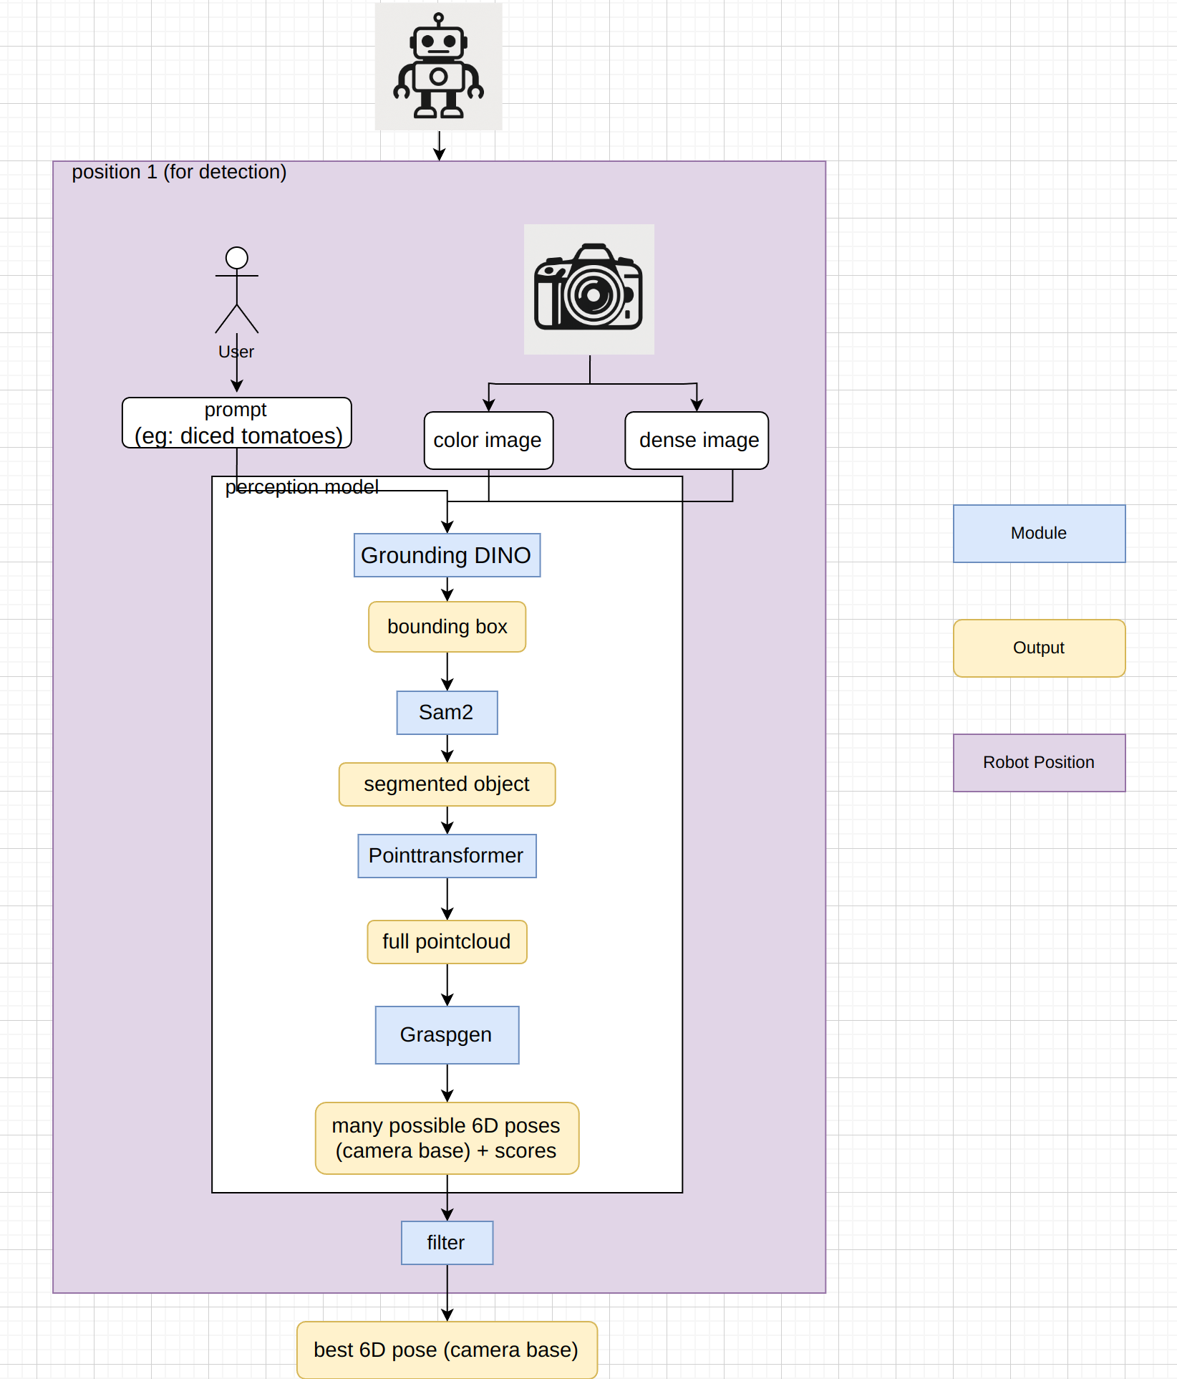
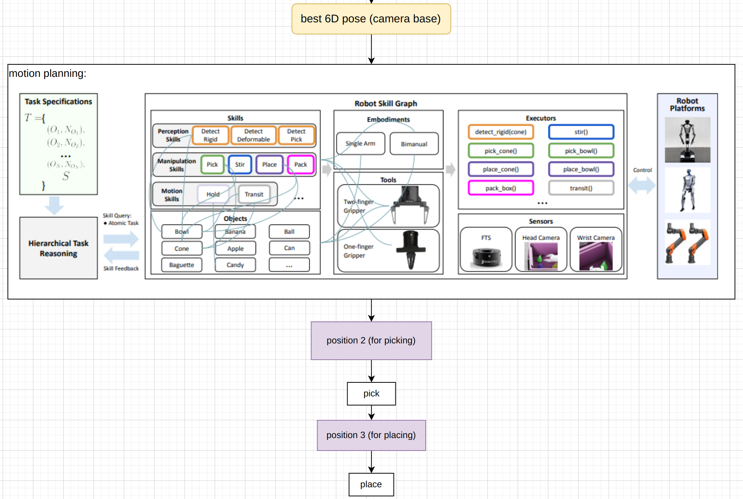
2. Pipeline
Perception
Manipulation

Slide 7
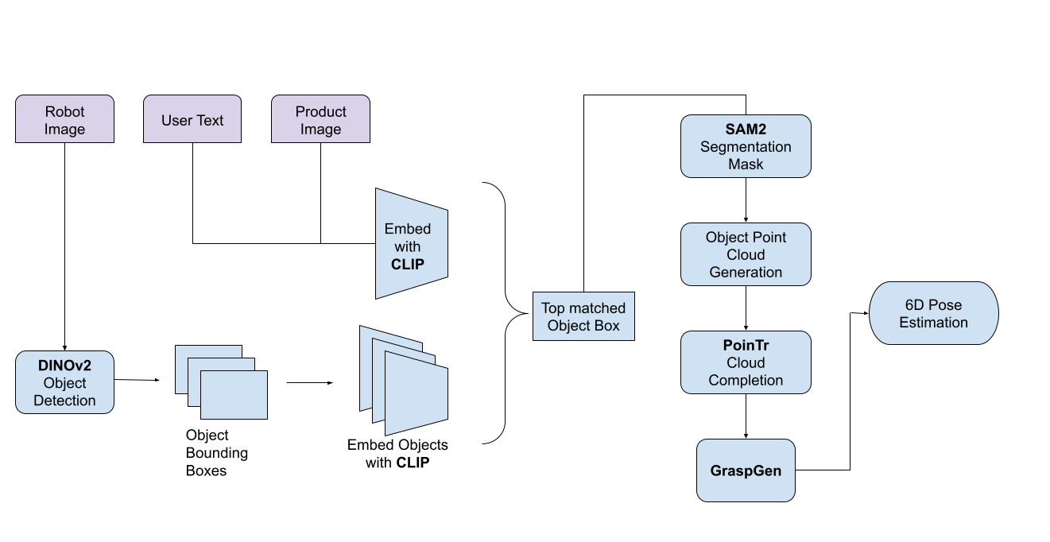
2.1 Perception Pipeline

Slide 8
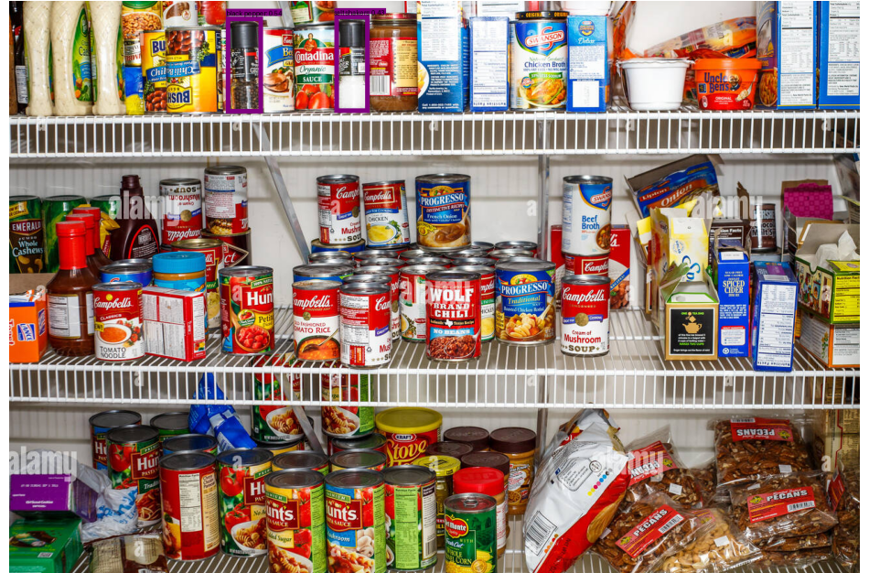
Get 2D Bounding Box
“
Salt and Pepper Shakers
User Input

Slide 9
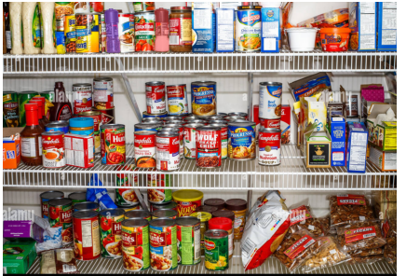
Get 2D Segmentation Mask
“
Salt and Pepper Shakers
User Input

Slide 10
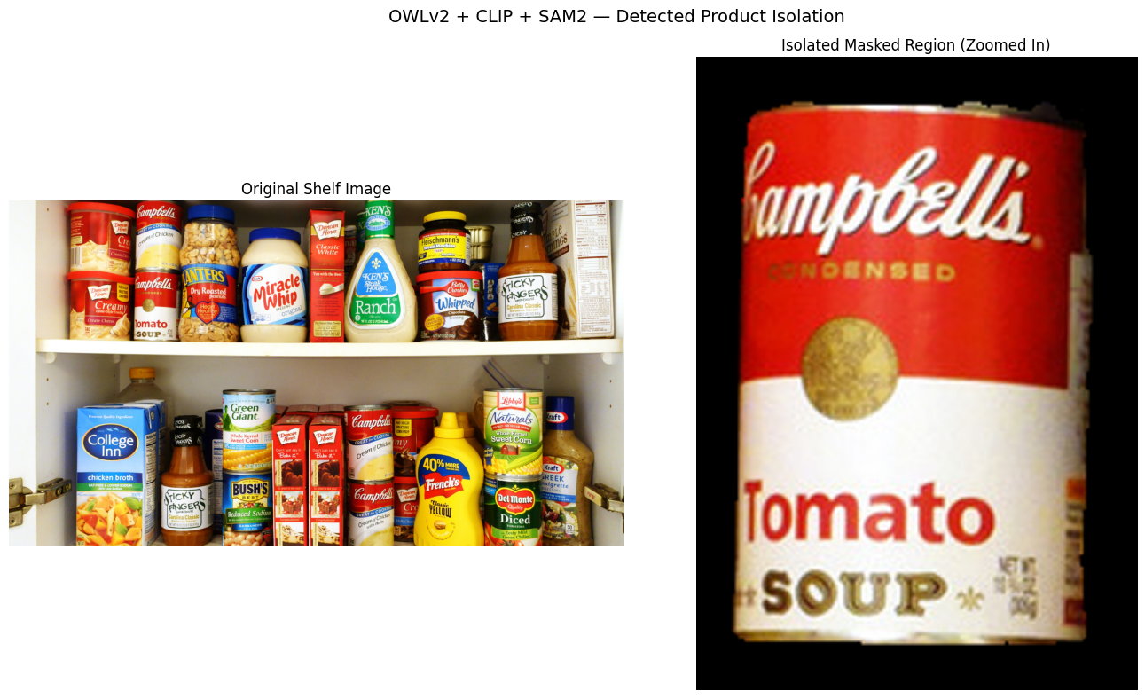

Slide 11
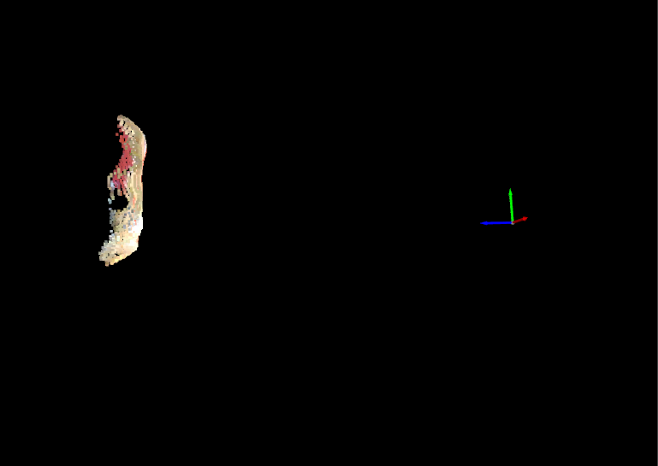
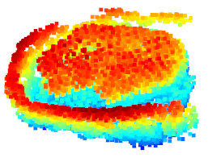
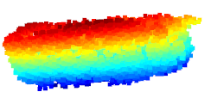
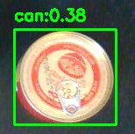
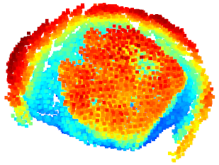
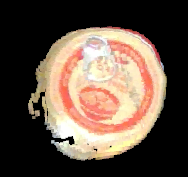
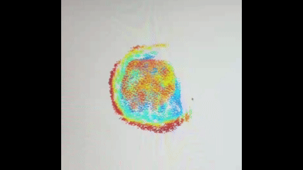
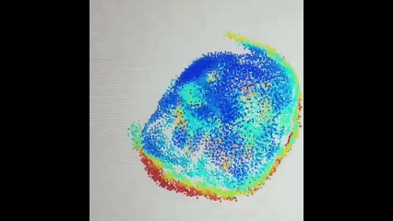
The performance of PoinTr(point cloud completion model)
Side view
Top view

Slide 12
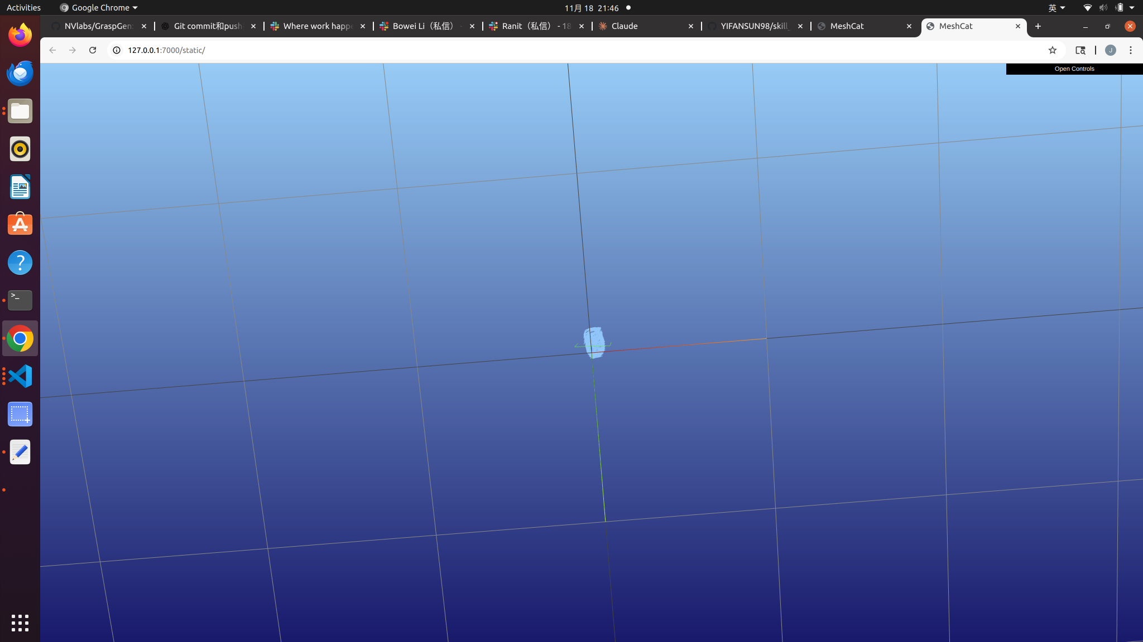
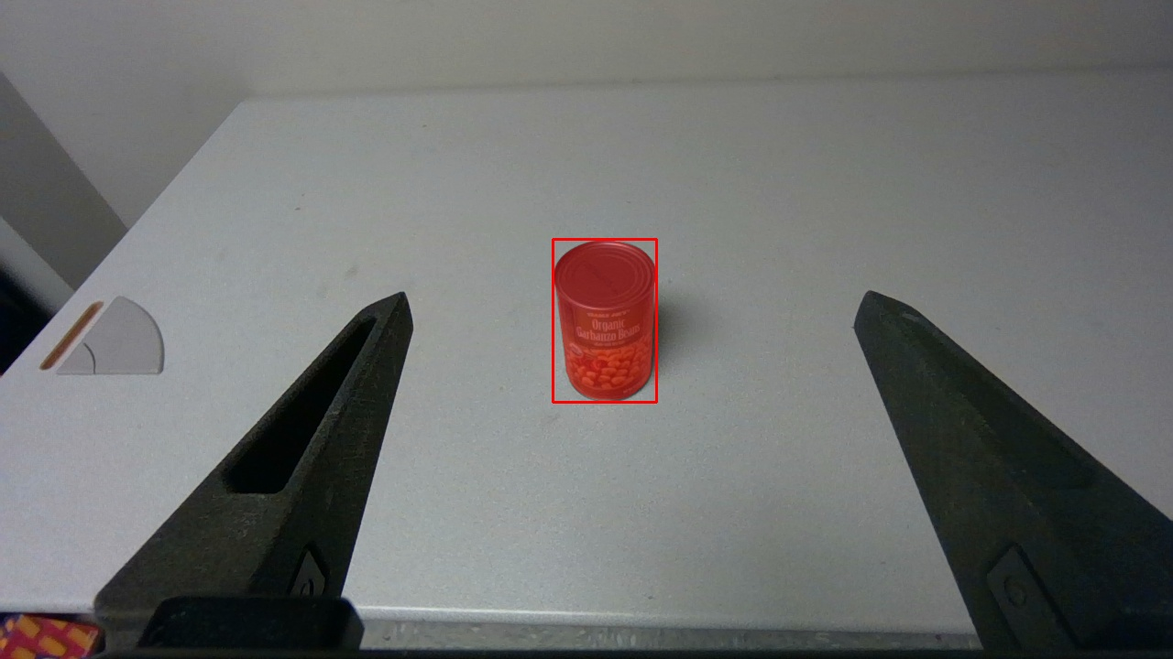
Gasping point showed in the

Slide 13
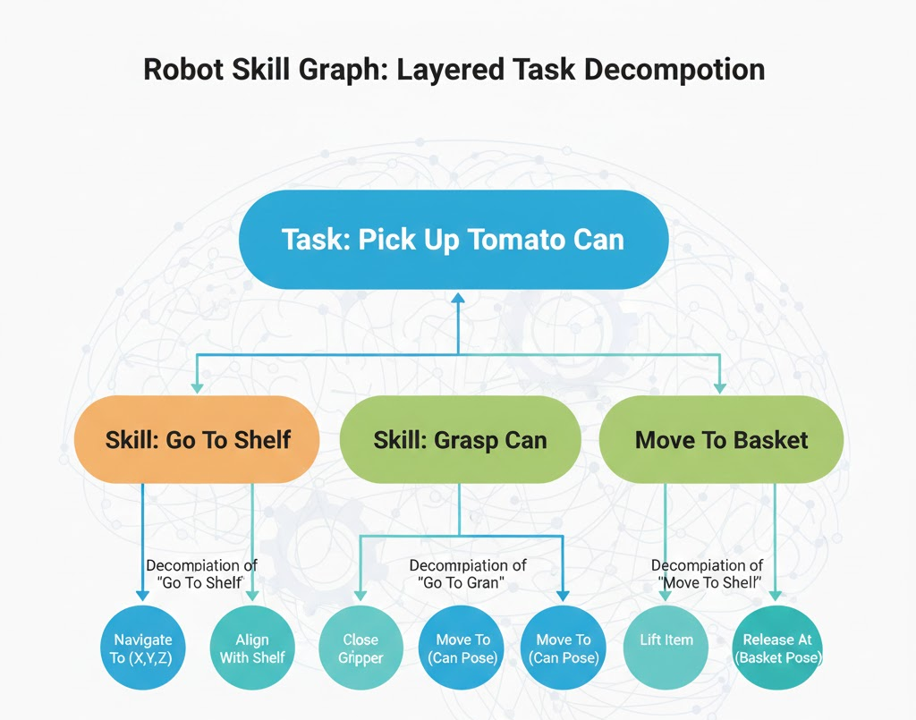
2.2 Manipulation Pipeline

Slide 14
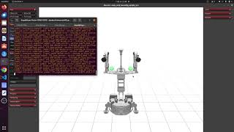
2.2 Manipulation In Simulation

Slide 15
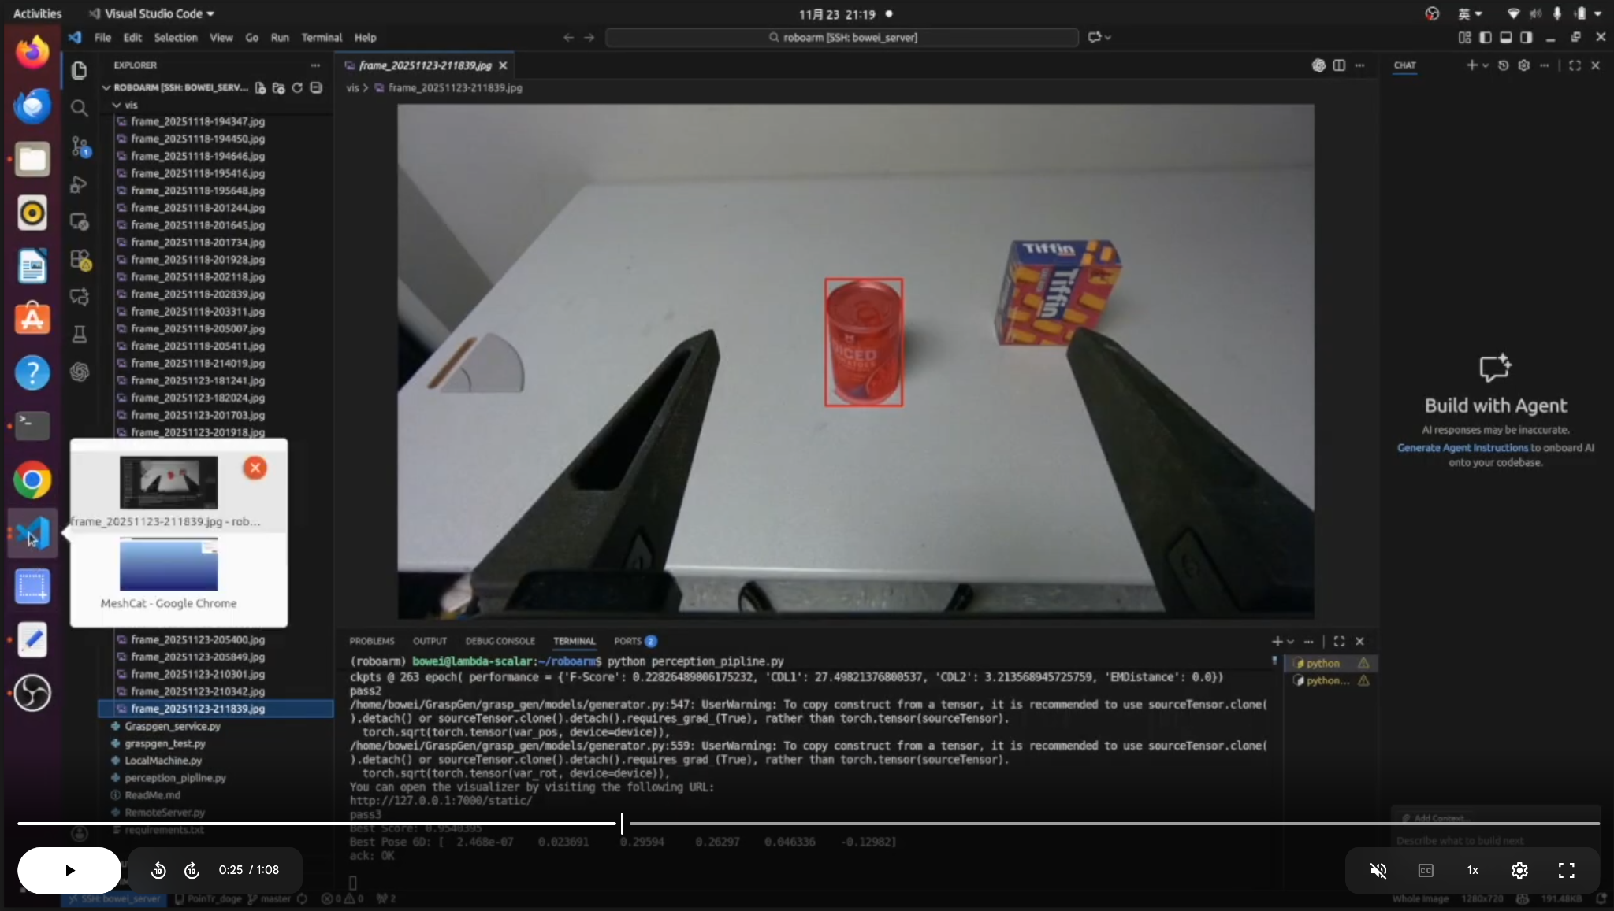
3. System Demo (AKA Manipulation in real life)

Slide 16
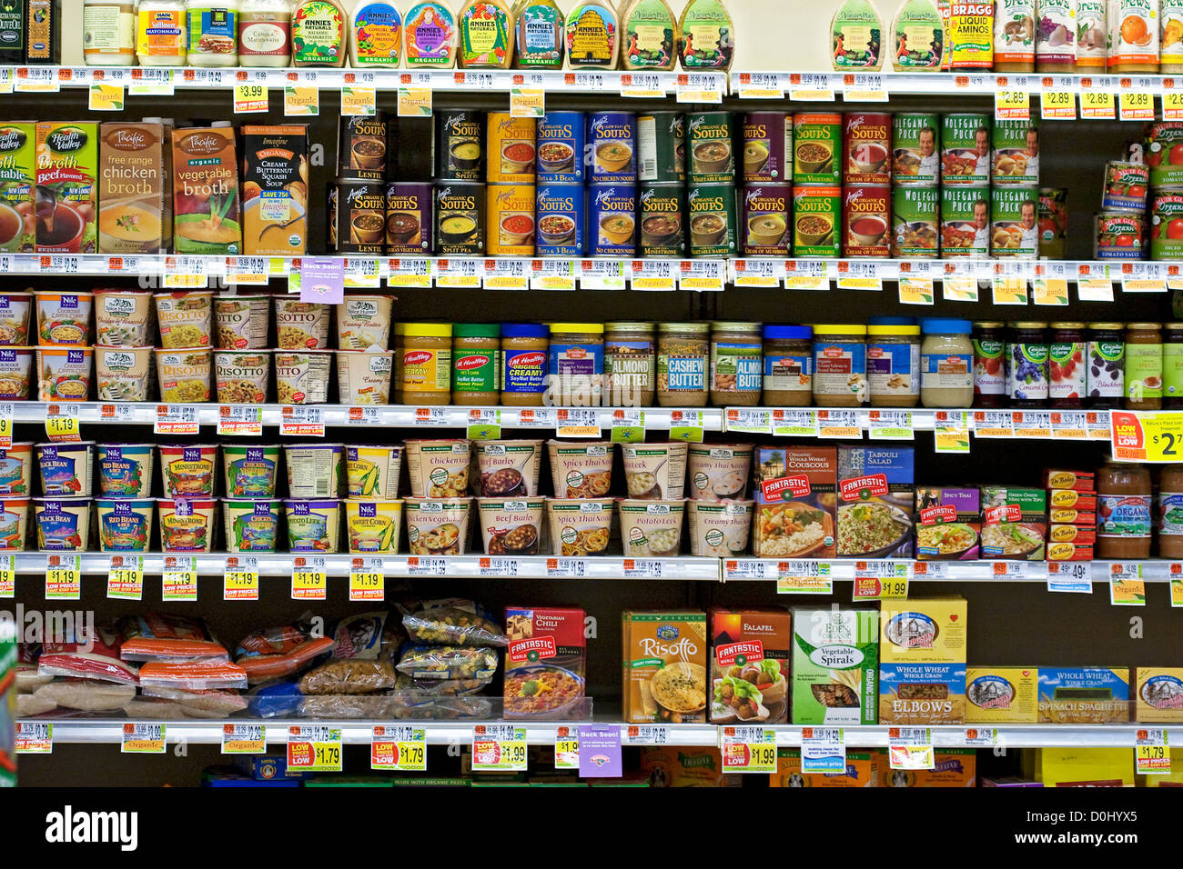
Approaching Crowded Shelf Space

Slide 17
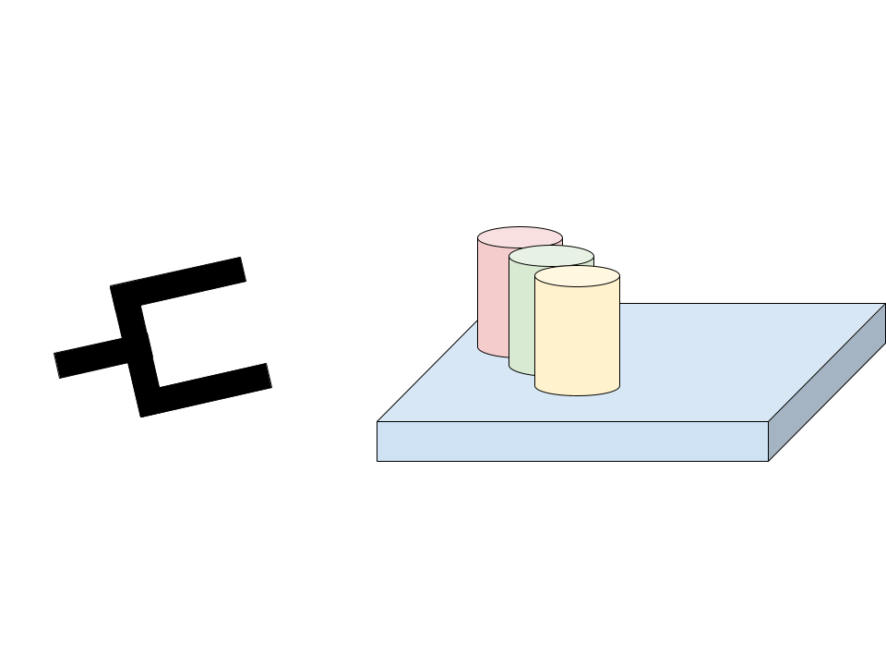
Approaching Crowded Shelf Space

Slide 18
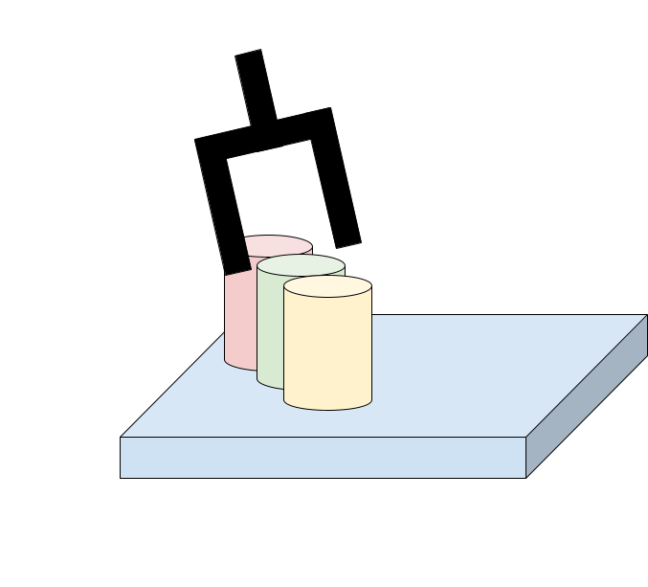
Approaching Crowded Shelf Space

Slide 19
Updates from pre-demo
Notes:
We all use mobile shopping apps, some time, we find it convenient to call an Uber Eat or do Curbside pickup.
However, it still takes time for the associates to pick up the items for us.
Can we make it more convenient for both the customer and the staff working in the shop?

Slide 20
4. Future Work
Dual-arm collaboration
More comprehensive collision detection
More user-friendly UI and LLM understanding

Slide 21
Thanks
Arm Grocery Shopper Team
Ranit, Bowei, Yikuan, Jianlin, Yuanliu, Han, Lihao

Slide 22
Vision Pipeline

Slide 23
Fixing Grasp Gen
Upright Filter
Gripper Offset

Slide 24
Upright Filter
Filtered pose close to the camera(pose with the smallest Z value): in “can” case, pose directly facing towards the object will be the best pose, not the side poses.

Slide 25
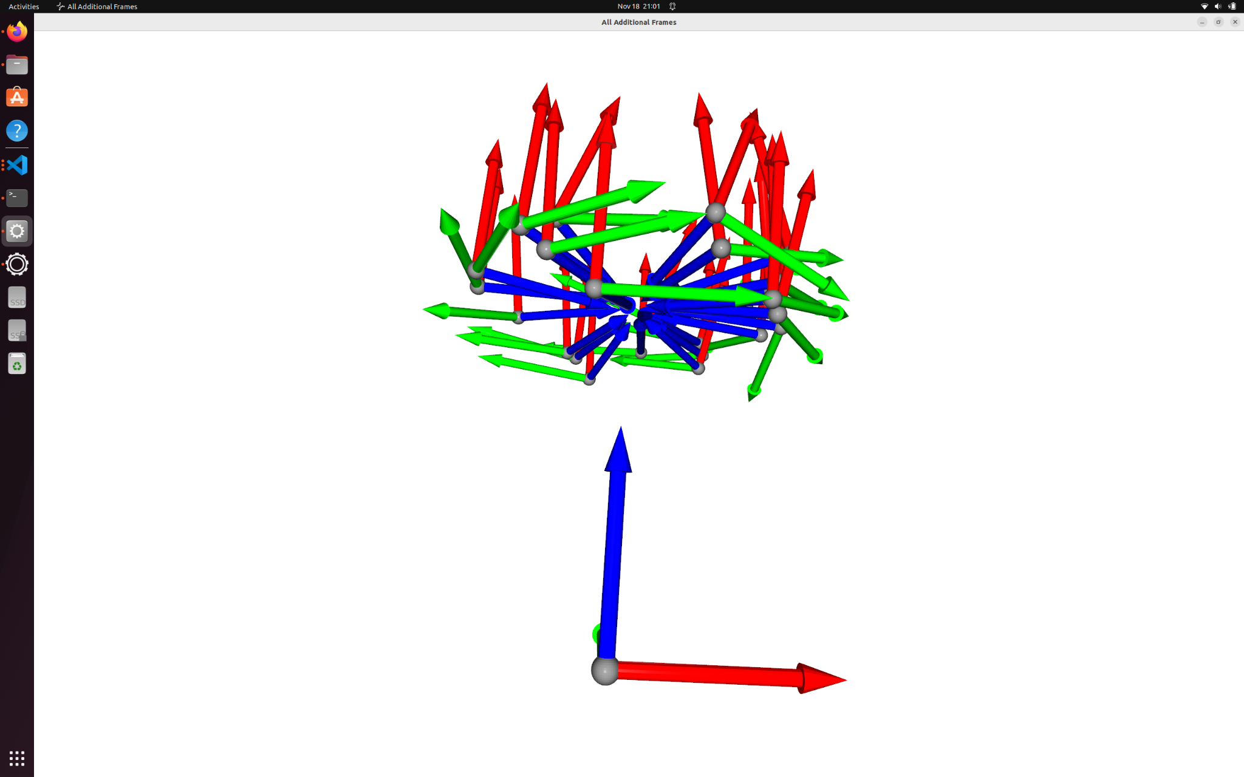
Upright Filter
Issue: Given the upright filter around cam Z axis=True

Slide 26
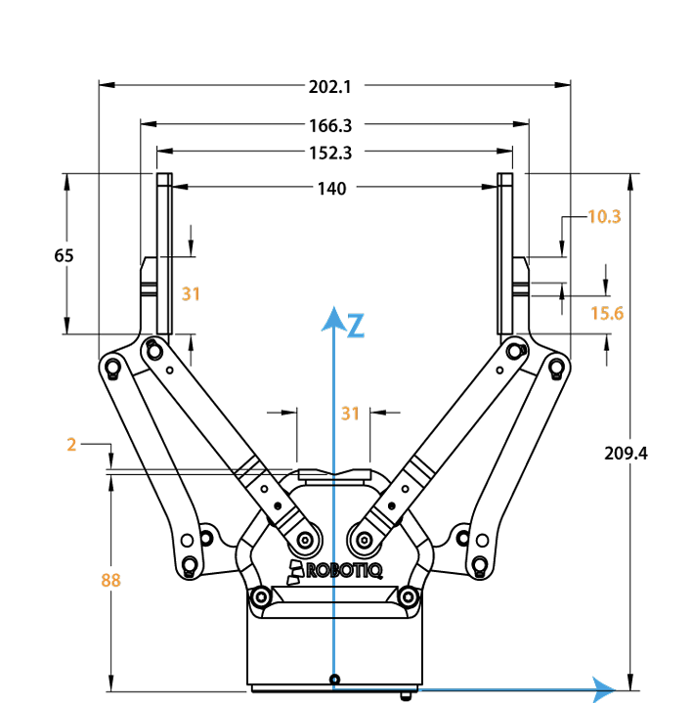
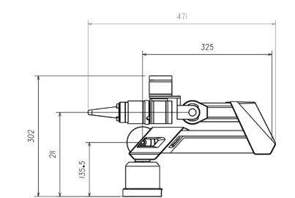
Gripper Offset

Slide 27
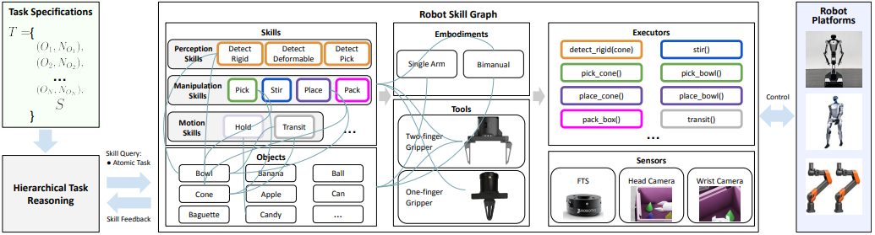
Skill graph (motion planning)
Input: best 6D pose (camera base)
Output: action
Implementation:
Process 1: transform 6D pose (camera base) to 6D pose (robot base)
Process 2: planning trajectory according to 6D pose (robot base)
Process 3: reach target position

Slide 28
11.19.2025

Slide 29
Filtered pose close to the camera(pose with the smallest Z value): in “can” case, pose directly facing towards the object will be the best pose, not the side poses.

Slide 30
issue:
Given the upright filter around cam Z axis=True

Slide 31
Motions in sim environment

Slide 32
11.7.2025

Slide 33
Demo Day!
Get Object Input
Find Object
In Remote Server
Pose Lost
Get Pose
Lost object / Failed to grasp
Actuation
Put to basket

Slide 34
Vision pipeline

Slide 35
Pipeline
Initial: Go to the detection position
Perception
Input：color image + dense image + user input (text prompt)
Output：best 6D pose (camera base)
Implementation: 1. Dino: text prompt→bounding box
2. Sam2 : boudingbox—> segmented object
3. Pointtransformer: mask + dense information →full pointcloud
4. Graspgen: full pointcloud—->many possible 6D poses + scores(camera base)
5. Filter: choose the best grasp position
Implementation: Relative to the camera's most recent position

Slide 36
Manipulation – Safe Trajectory Selection
https://drive.google.com/file/d/17BLArBKfSiBW9LJ05nhuEEca3uQim3fs/view?usp=sharing

Slide 37
10.20.2025

Slide 38
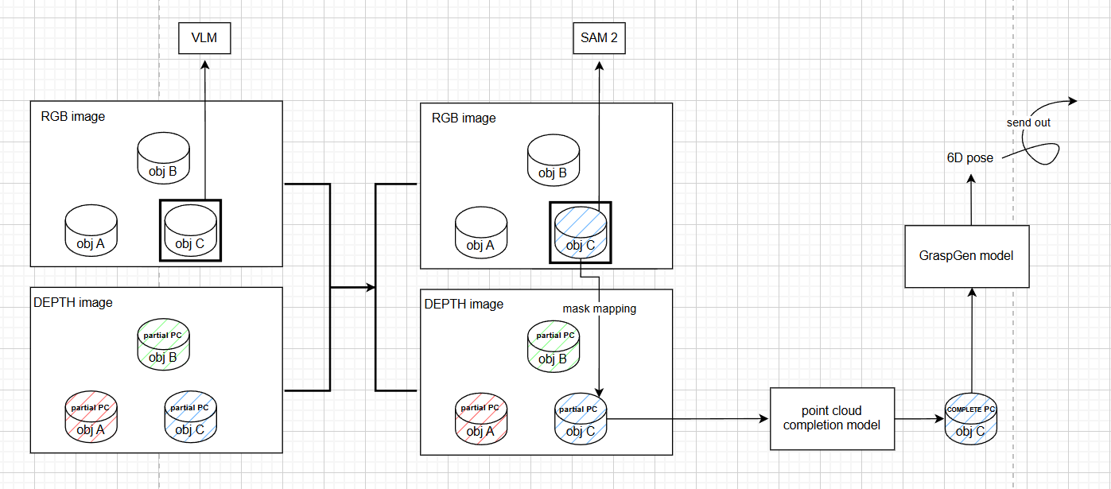
A general view of vision pipeline

Slide 39
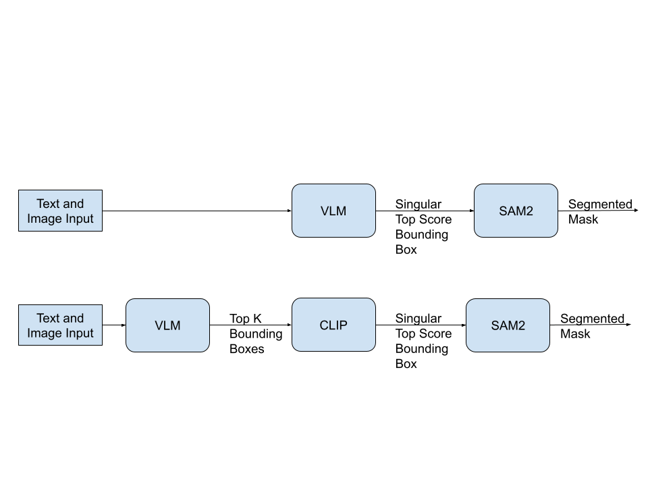

Slide 40
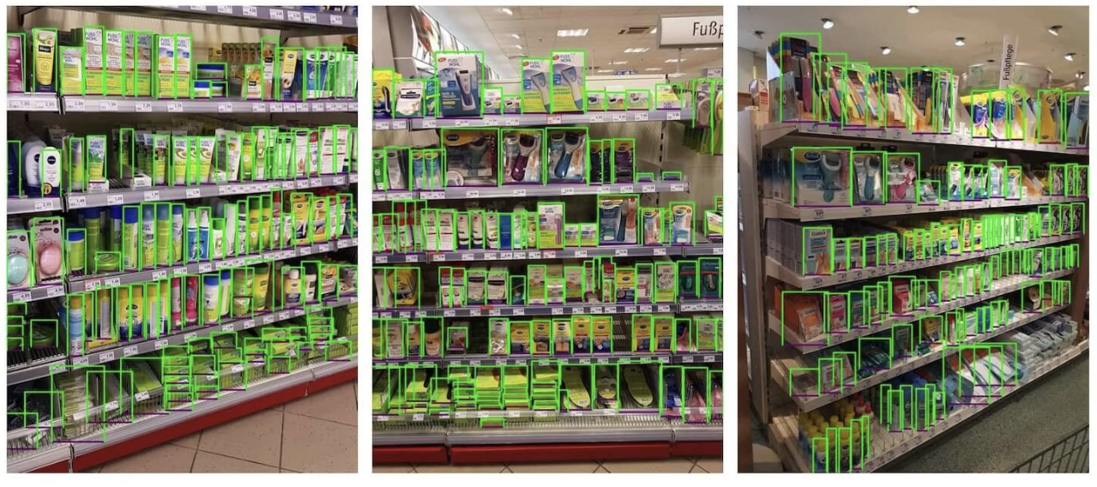
Using Yolo v5 trained on SKU Dataset
110K images of densely packed shelves of products
Generic “product” label that detects generic packaging items like cans, boxes, bottles, etc.

Slide 41
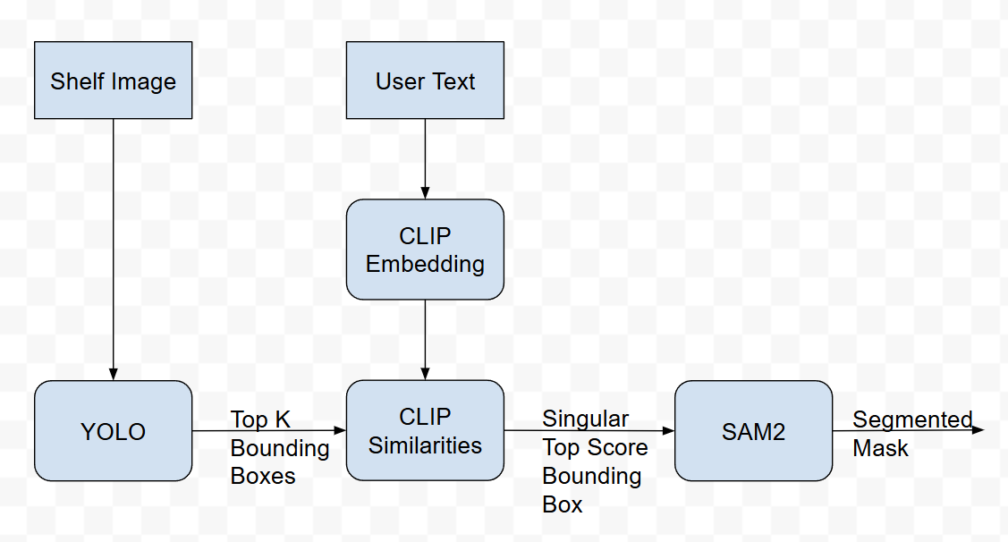

Slide 42
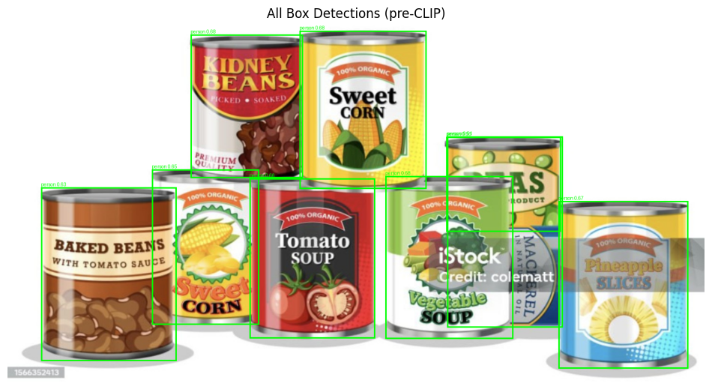

Slide 43
"Can of Peas"

Slide 44
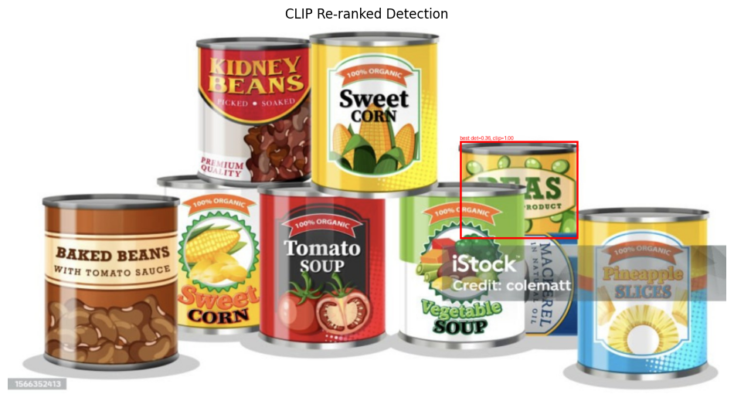

Slide 45
10.06.2025

Slide 46
A general view of vision pipeline

Slide 47
Issue: One Shot Object Detection using VLMs

Slide 48
Test 1: Testing Multiple VLMs

Slide 49
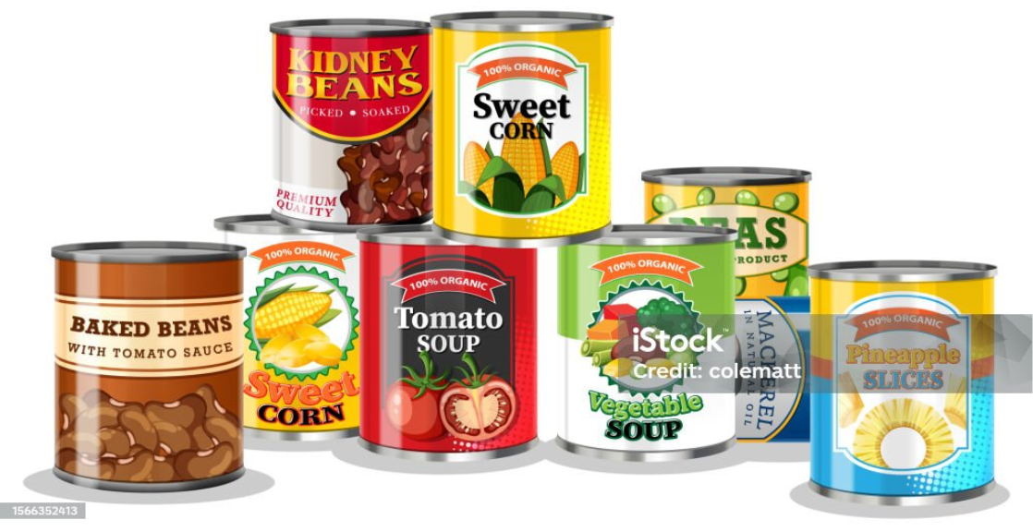
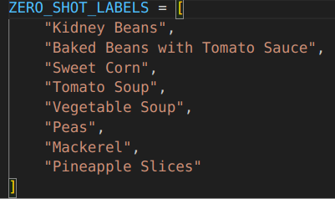
Performance Comparison
SIgLIP By Google DeepMind (Vision-language embedding model)
OWLV2 By Google Research (Open-vocabulary object detector)
QWen2.5-VL By Alibaba (General-purpose multimodal LLM (VLM + LLM))

Slide 50
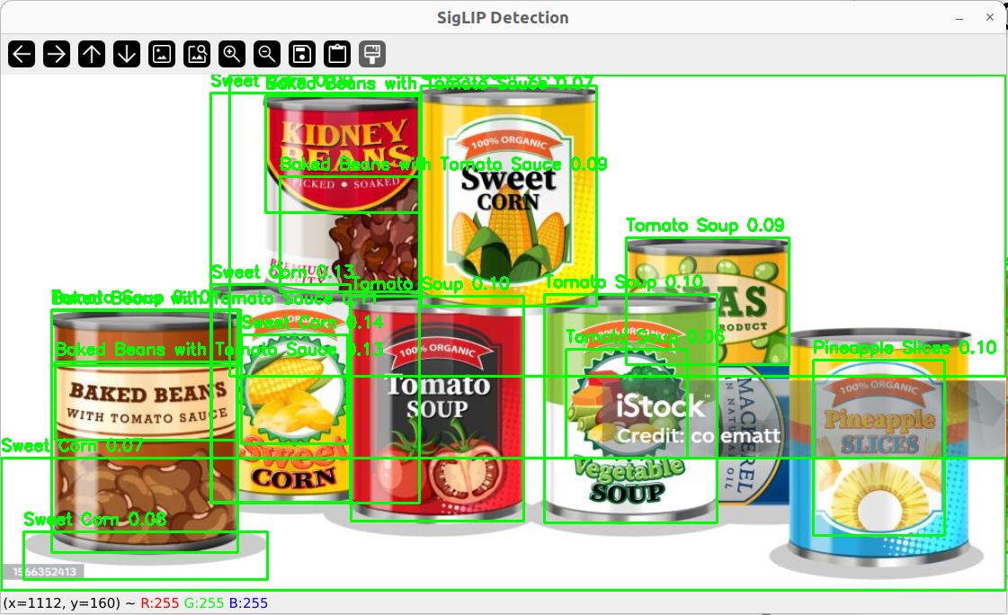
SigLIP(Sigmoid CLIP)

Slide 51
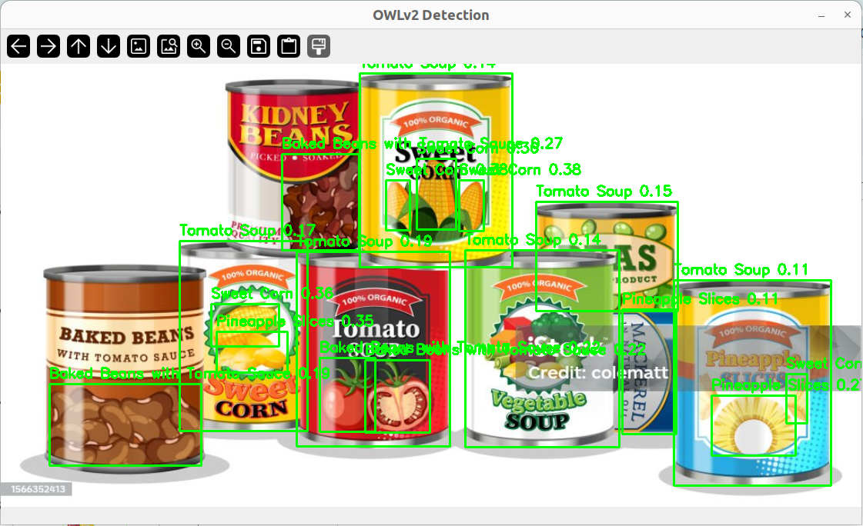
OWLV2(Open-World Localization v2)

Slide 52
QWen2.5-VL

Slide 53
Model | Type | Strength | Weakness | Best Use
OWLv2 | Detector + Text | Accurate boxes, multi-class | Limited open-world generalization | Zero-shot detection, SAM pre-masking
SigLIP | Embedding | Strong alignment, fast | No spatial grounding | Retrieval, embedding similarity
Qwen 2.5-VL | Generative VLM | Rich semantics, multilingual | No detection, heavy | Reasoning, VQA, semantic grounding

Slide 54
Test 2: Adding CLIP Reranking

Slide 56
"Campbell's red and white tomato soup can"

Slide 57
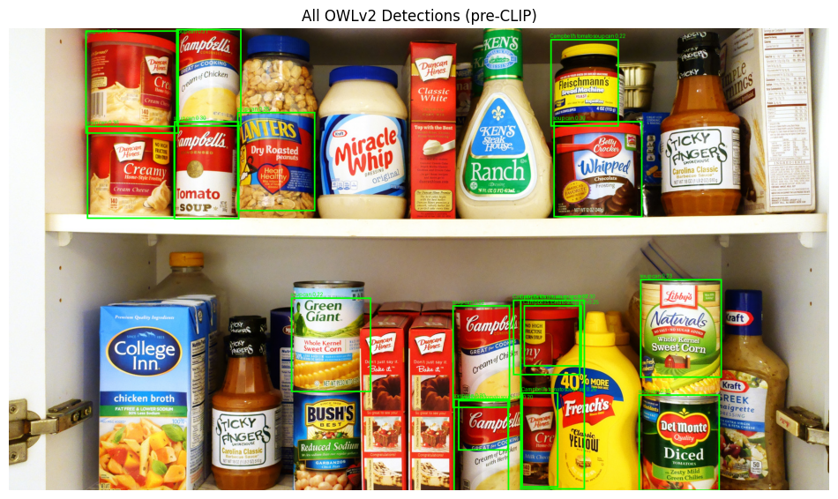

Slide 58
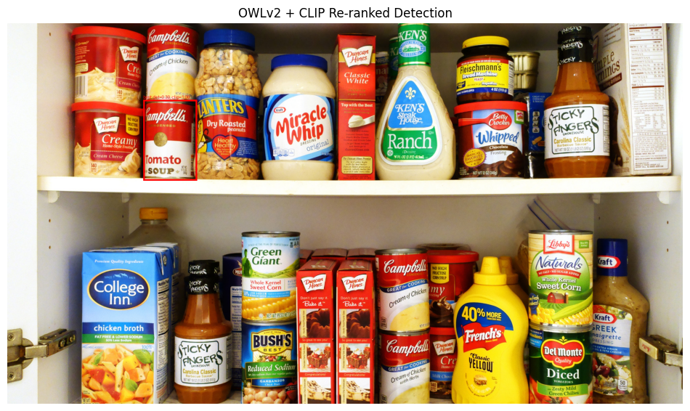

Slide 59
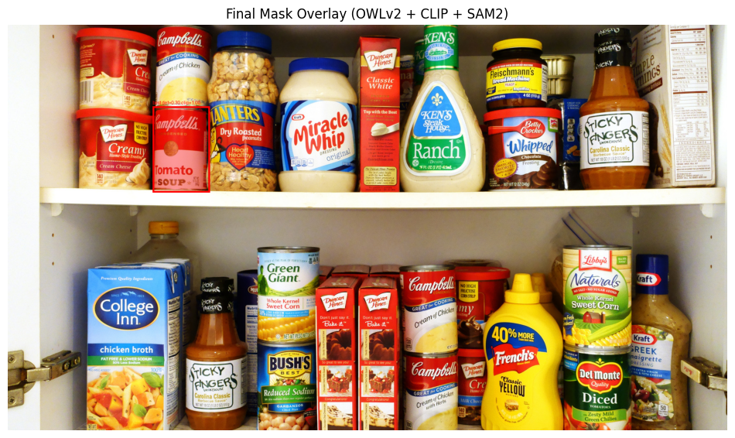

Slide 61
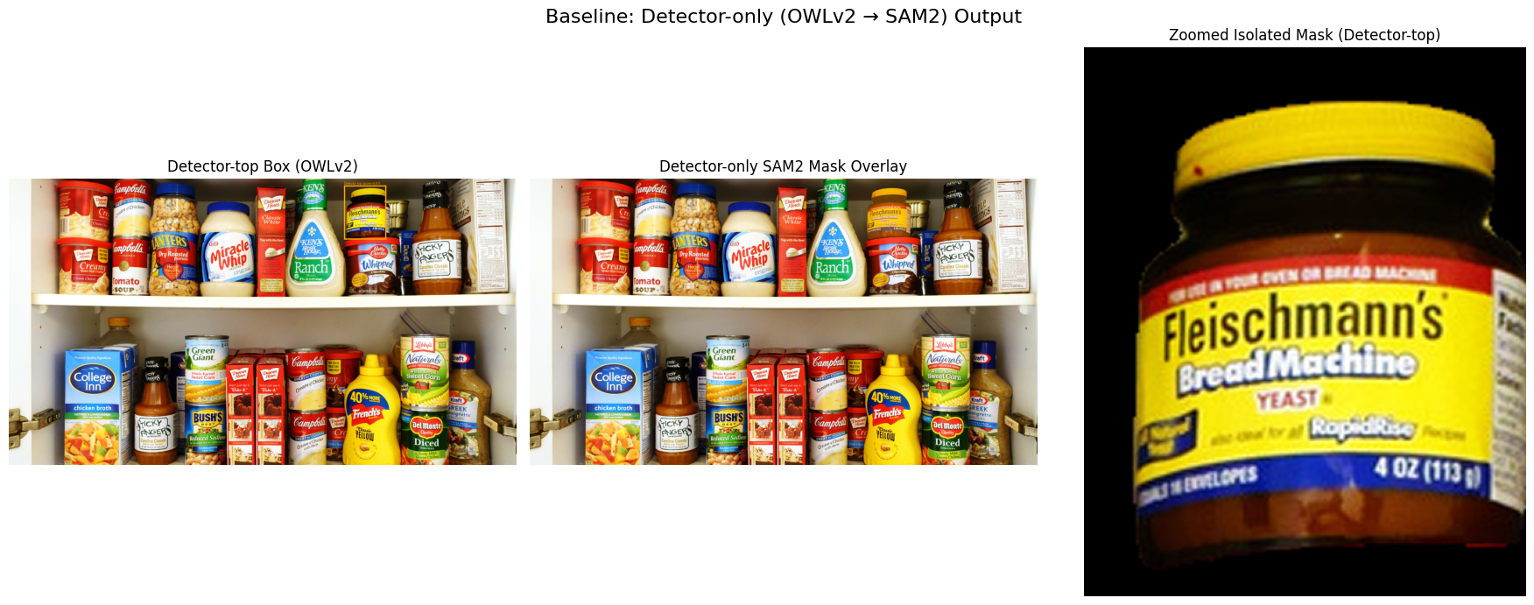

Slide 62
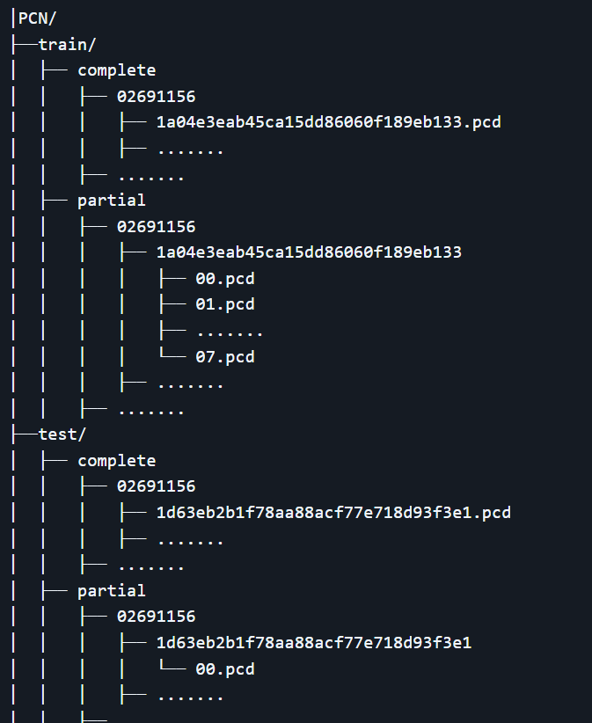
Synthetic dataset generation for fine tuning PC completion model
Mesh model from the open resources: The YCB Object and Model Set: Towards Common Benchmarks for Manipulation Research
Convert mesh model into point cloud
Random sampling complete point cloud from multi cam-views(N) to generate (1 complete PC, N partial PC) data pairs.
Re-arrange the PC data pairs into PCN dataset format, used for FT poinTr model

Slide 63
The performance of PoinTr(point cloud completion model)
Side view
Pretrained model
Top view

Slide 64
PC_completion model(PoinTr) Fine-tuned results
Completed PCD files: https://drive.google.com/drive/folders/1qgKzcFvokhn9vDwrDxb5LIuXDfEUvHOj?usp=sharing
Online PCD visualizer:
online pcd viewer

Slide 65
9.29.2025

Slide 66
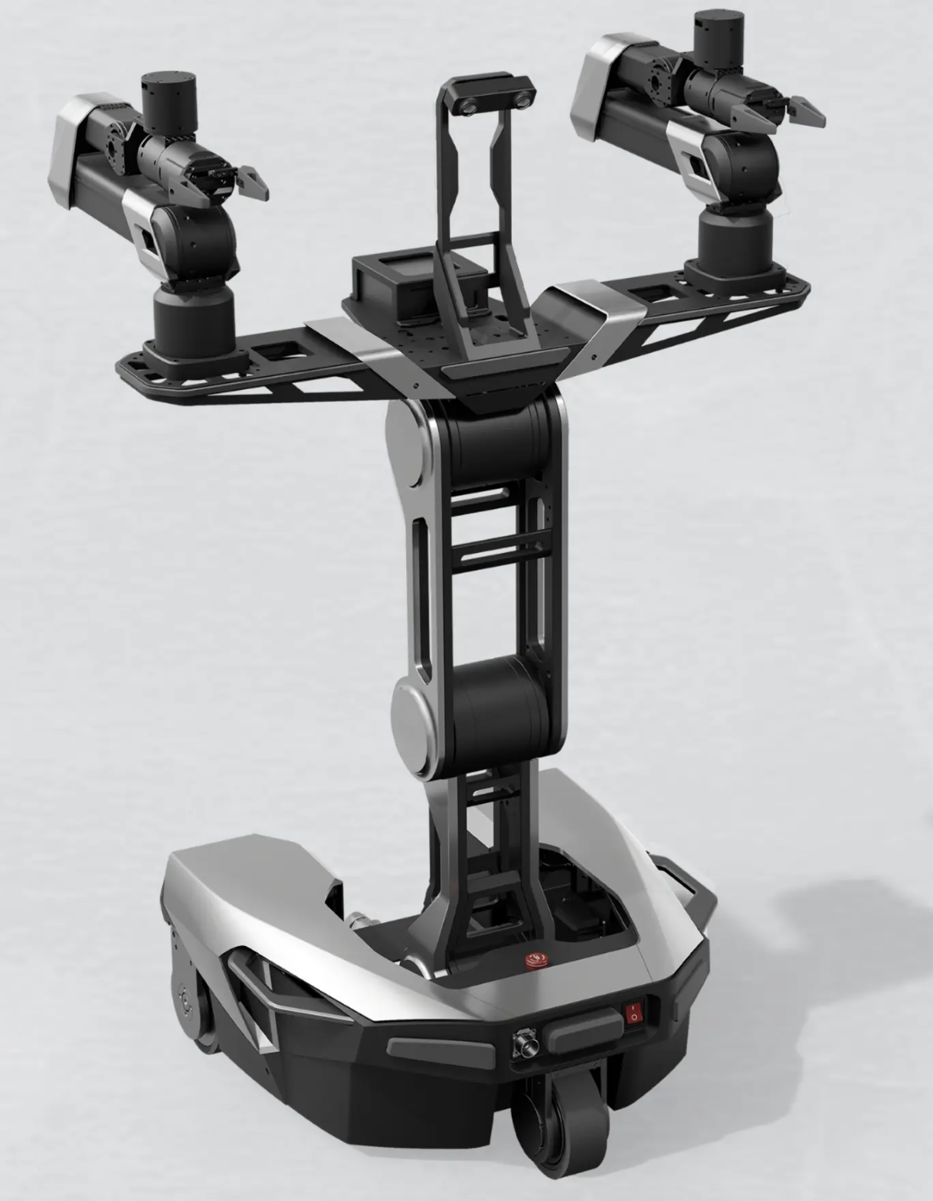
0. Galaxea R1 Lite
Dual 6-DOF Arms with Grippers
600mm reach (~2ft)
Typical load 3kg, Maximum load 5kg.
3DOF Body
Vertical elevation of 1.7m
Omnidirectional Chassis
Intel Core i9-12900HK 32GB RAM 1TB SSD
Binocular camera x1 (Head)
Depth Camera x2 (Each side wrist)

Slide 67
0. Galaxea R1 Lite
Keyboard teleop demo:
https://drive.google.com/file/d/1HRkEWN0kjXuUHJKT46ypccUfxe_bq-nG/view?usp=sharing
Keyboard teleop real demo:
https://drive.google.com/file/d/1W4uI6dXL5DDIPdimmUsWVhI75n7Ssbsm/view?usp=sharing
Skill graph demo:
https://drive.google.com/file/d/11TkfmO8zgZW7tU07rEvQxNKdpF1jgDS9/view?usp=sharing

Slide 68
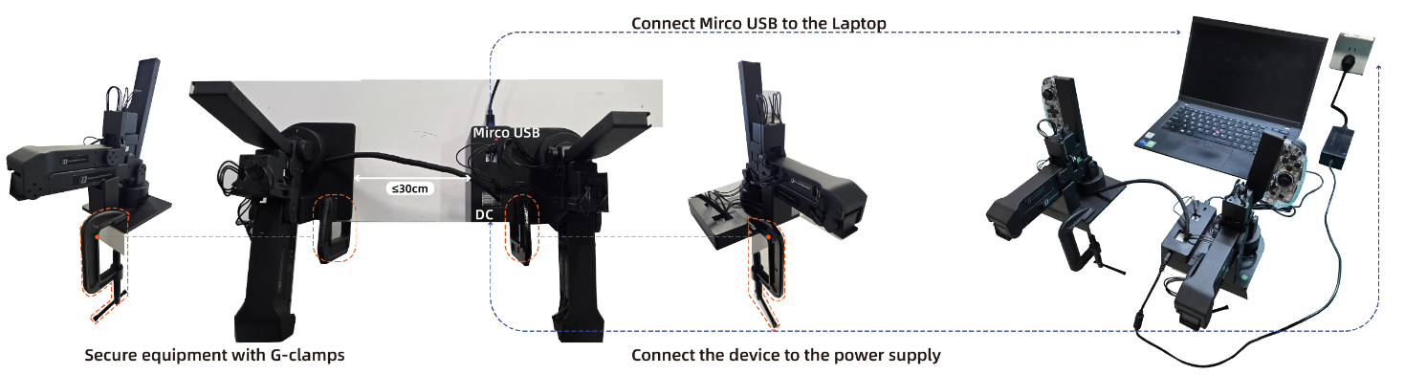
0. Galaxea R1 Lite – Isomorphic Teleoperation System

Slide 69
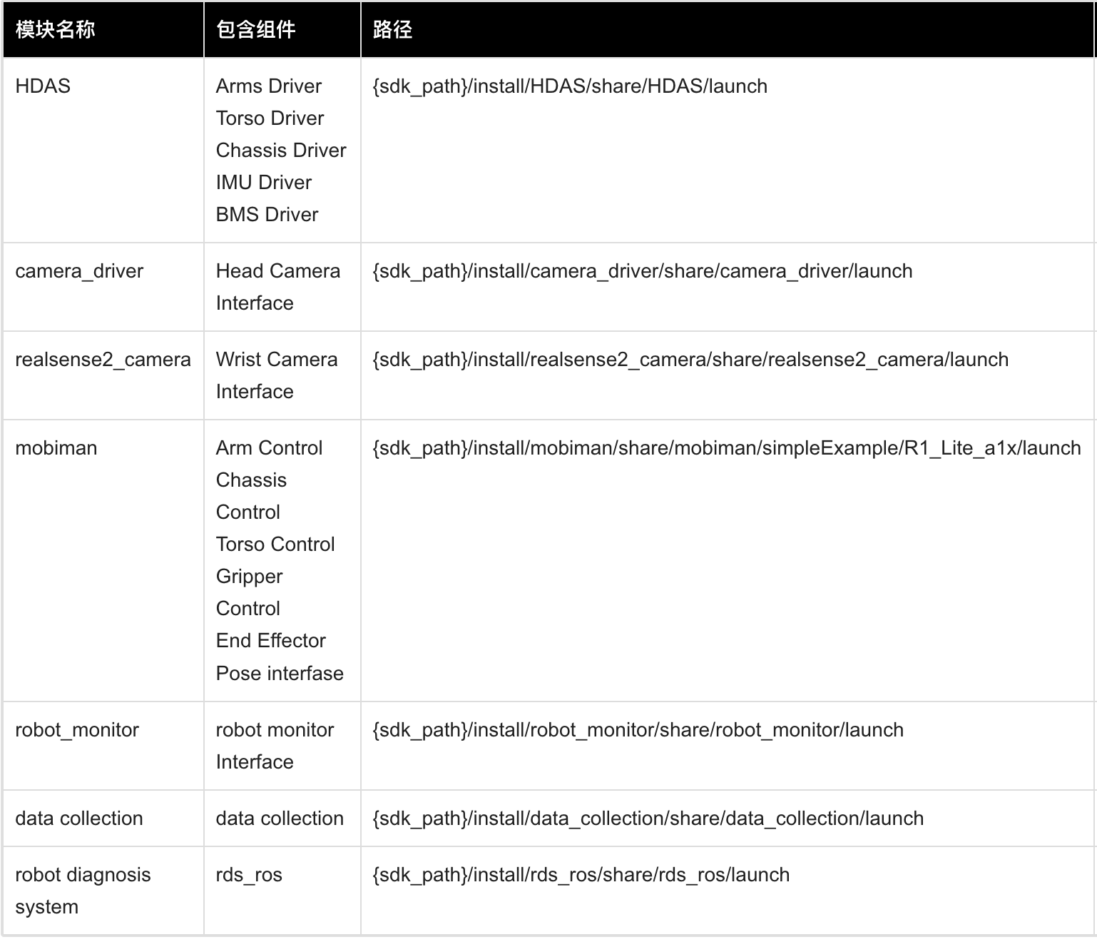
0. Galaxea R1 Lite – ROS2 Control Framework

Slide 70
Project scope – Whole Picture
Semantic understanding based path finding
The robot will be able to navigate to the corresponding location described by natural language
Dual Arm collaborative pick and place
Target item will be identified and localized by VLM
Trajectories and gripping points will be generated by the dual arm task planner
Dual arm collaboration schedule will also be generated

Slide 71
Project scope – Whole Picture
Semantic understanding based path finding
The robot will be able to navigate to the corresponding location described by natural language
Dual Arm collaborative pick and place
Target item will be identified and localized by VLM
Trajectories and gripping points will be generated by the dual arm task planner
Dual arm collaboration schedule will also be generated

Slide 72
2. Environment Setup
Fixed base dual arm robot
Shelf with fixed relative translation
Experiment will be focused on limited variations of objects
Cereal Box (Biscuit Box, Pasta box)
Soup Can
Candy bag
We also will take into consideration the collaboration of dual arms
We will also stream the FPV video to a monitoring device, if the auto grasping fails, the human tele-operator will step in.

Slide 73
3. Perception

Slide 74
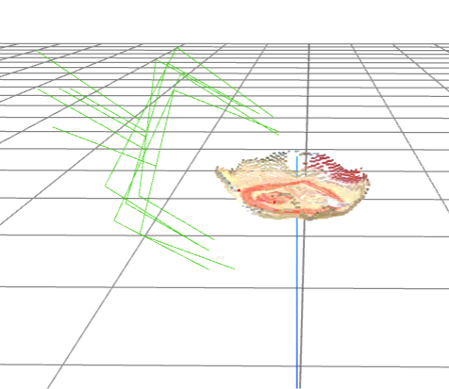
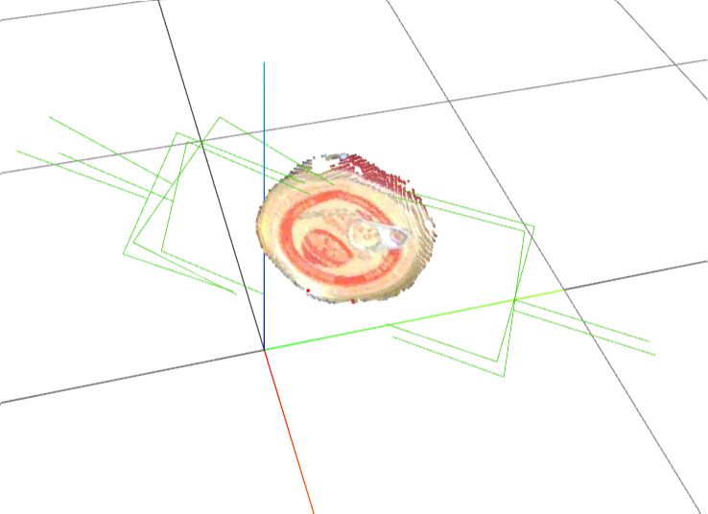
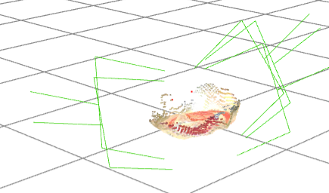
4. Manipulation – End-Goal generation
Based on the segmented mask, we can generate the gripper pose (SE4 set) directly. Since the format of the pointcloud after pc completion model is not aligned with the input requirement of the GraspGen model, we only used the output from SAM result currently.

Slide 75

4. Manipulation – Safe Trajectory Selection
Control Barrier Function

Slide 76

4. Manipulation – Safe Trajectory Selection
Control Barrier Function – Obstacle Localization

Slide 77
4. Manipulation – Safe Trajectory Selection
https://drive.google.com/file/d/17BLArBKfSiBW9LJ05nhuEEca3uQim3fs/view?usp=sharing

Slide 78
4. Manipulation – Trajectory Execution
HTR and Skill Graph

Slide 79
5. Plan forward
Will be implementing the middleware of the robot and actuate all components of the new robot in current pipeline
Upon completion, we will first try a small demo of single arm pick and place

Slide 80
9.22.2025

Slide 81
Required softwares
Simulation Platform:
Gazebo, Mujoco
Communication middleware:
ROS2
Teleoperation set:
Apple Vision Pro

Slide 82
Grasping pose generation + 6D pose estimation pipeline
Intended Object segmentation based on human language:
VLM: GroupViT or DINO
Seg model: SAM2
Point Cloud Completion from Partial Observation:
point completion model(PointTr)
Grasping pose generation + 6D pose estimation:
GraspGen model for grasping pose generation (May need some finetune for unseen objects)
ICP(point-cloud registration) in WBCD competition help for 6D pose estimation.

Slide 83

A general view of experiment setting

Slide 84
A general view of vision pipeline

Slide 85
Get 2D Bounding Box
“
Salt and Pepper Shakers
User Input

Slide 86
S
Get 2D Segmentation Mask
“
Salt and Pepper Shakers
User Input

Slide 87
S
Get Segmentation Mask
Use Mask to filter the Realsense Pointcloud (3D)
Run PointTr model for Pointcloud completion
Run graspGen to calculate 6D Pose Position

Slide 88



VLM Pipeline
Combined with a VLM model and SAM model, we can get the segmented can mask from a given image input

Slide 89
The performance of PoinTr(point cloud completion model)
Side view
Top view

Slide 90

The paper’s evaluation metric for both seen and unseen cases
CD means chamfer distance, the smaller the better

Slide 91

A grocery dataset can potentially be used for training PC completion model
3Dgrocery100 dataset
Point cloud data isn’t complete, need multi images fusion techniques to collect complete grocery point cloud data to train Point cloud completion model.

Slide 92
The Performance of GraspGen
Based on the segmented mask, we can generate the gripper pose (SE4 set) directly. Since the format of the pointcloud after pc completion model is not aligned with the input requirement of the GraspGen model, we only used the output from SAM result currently.

Slide 93
VLM Pipeline Demo
https://drive.google.com/file/d/14Cbqs2uV1GmdFiiMEWlyZlNmpy_xSHaS/view?usp=drivesdk
https://drive.google.com/file/d/1fVgC0HAKgAGY6hCCHRbEG9Y9LlSU0FP7/view?usp=drivesdk

Slide 94
R1lite
Real machine:
https://drive.google.com/file/d/11Wh_pQgFOO1oNAed2ib11gnmWZ77HTN9/view?usp=drive_link
https://drive.google.com/file/d/1g-T-tIV-8kcIomoXEz3_yDl346ANmPI1/view?usp=drive_link
Simulation:
https://drive.google.com/file/d/1VxBnEZR92pkkPFPpRkItpPn_WV5tXa6i/view?usp=drive_link

Slide 95
Teleop: Robot tracks hand’s operation
Enable: pinch your right index finger
Usage:
keeping the pinch right index finger:
Control the robot to move by moving left hand (relative to robot base)
Control the gripper’s rotation by rotating the left wrist (absolute)
Control the gripper’s on/off by opening and closing of the hand
releasing pinch: adjust the position of hand for the starting position of the hand for the next teleop
Demo: https://drive.google.com/file/d/1OOLrau5uZt-vgEDRh9e_Wxf9z7mD2AAK/view?usp=share_link

Slide 96

Teleop

Slide 97

Teleop
· Human user
Wears the Apple Vision Pro
Interacts with the system via gestures (pinch) and speech

Slide 98

Teleop
· Robot System
Industrial manipulator + three-finger gripper
Task objects

Slide 99

Teleop
· Runtime PC
Receives robot sensor data
Runs control algorithms
Communicates bidirectionally with the AR headset via gRPC

Slide 100

Teleop
· Apple Vision Pro
Hand tracking
Spatial localization
Speech recognition
AR rendering

Slide 101

Teleop
· Developer PC
Designing virtual objects/UI
Deploying apps to Vision Pro

Slide 102
https://drive.google.com/drive/folders/1J_BP6FoNayC411fi5XLnelsUyMFDnblK?usp=drive_link
https://drive.google.com/drive/folders/1t72oMd9dy88RH0O50viPiOVc0gjA8fqU?usp=drive_link

Slide 103


